Slide 1

CLOTHES STORE MANAGEMENT
GROUP 7

Slide 2
MEMBERS
MEMBERS OF GROUP 7: 1. Nguyễn Tuấn Khải BI11-116 (LEADER) 2. Trần Duy Hưng BI11-105 3. Nguyễn Quang Huy BI11-113 4. Hà Phúc Khiêm BI11-121 5. Lê Khánh Minh BI11-177 6. Võ Thuỳ Trang BI11-270 7. Trần Quý Dương BI11-067

Slide 3
TABLE OF CONTENTS
01
02
03
Introduction
Program Structure
Demo Program
The reason why this program have developed
Our code for the Clothes Managing Program
How the Program works
04
Conclusion
What we have done and What we want to

Slide 4


INTRODUCTION
01

Slide 5
PROBLEM
Imagine that you are a small clothes designer. You can produce and sell them, but in very small scale (the quantities of clothes you produce and sell is very small, and only by yourself).

Slide 6
PROBLEM
But now you are owning a bigger store, with more than hundreds products are sold in one day. Everything must be more professional. Then how can you manage it ?

Slide 7

SOLUTION
Let the computer and software do it for you.

Slide 8
SOLUTION
Let the computer and software do it for you. A program that can manage all of it.

Slide 9

STRUCTURE OF THE PROGRAM
02

Slide 10
CLASSES
We have 2 main class: class Application and class Database
For designing the structure of the program
class Application
class Database
For creating and managing the data of clothes from the staff

Slide 11
CLASSES
We have 2 main class: class Application and class Database
class Application
def __init__(self, master):
super().__init__(master)
self.master = master
master.title('Seven Boutique')
# Width height
master.geometry("700x400")
# Create widgets/grid
self.create_widgets()
# Init selected item var
self.selected_item = 0
# Populate initial list
self.populate_list()
🡪 For designing the structure of the program

Slide 12
CLASSES
We have 2 main class: class Application and class Database
class Database
def __init__(self, db):
self.conn = sqlite3.connect(db)
self.cur = self.conn.cursor()
self.cur.execute()
self.conn.commit()
🡪 For creating and managing the data of clothes from the staff

Slide 13
PACKAGES
We have 5 file of python for the Management Program:
Login.py
Staff.py
Part_manager.py
Part_manager_oop.py
Db.py

Slide 14
LOGIN.PY
1
PACKAGES
def login(t: Tk):
entered_user = e1.get()
entered_pass = e2.get()
if (entered_user == "admin" and entered_pass == "123"):
messagebox.showinfo("","logged in as admin")
t.destroy()
call(["python","admin.py"])
elif (entered_user == "staff" and entered_pass == "123"):
messagebox.showinfo("","logged in as staff")
t.destroy()
call(["python","staff.py"])
else:
messagebox.showinfo("","invalid user or password")
This part create a security and defining the role system for the user of the program.
There are 2 roles: Admin and Staff.
Each role have different right and action that you can do with the program.

Slide 15
STAFF.PY
2
PACKAGES
def open_part_manager(t: Tk):
t.destroy()
subprocess.call(["python“, "part_manager.py"])
bt1 = Button(cloth, text="Remaining", font=('Times New Roman',20, 'italic', 'bold'), bg='#808080')
bt1.pack()
bt2 = Button(cloth, text="Order", font=('Times New Roman',20, 'italic', 'bold'), bg='#808080', command=lambda: open_part_manager(cloth))
bt2.pack()
When you login as Staff, these codes will create a table. That include some buttons and blanks for you to take the order form.

Slide 16
Part_manager.py
3
PACKAGES
def populate_list():
clothes_list.delete(0, END)
for row in db.fetch():
clothes_list.insert(END, row)
def add_item():
if clothes_text.get() == '' or customer_text.get() == '' or retailer_text.get() == '' or price_text.get() == '' or order_time_text.get() == '':
messagebox.showerror()
return
def select_item(event):
def remove_item():
db.remove(selected_item[0])
clear_text()
populate_list()
def update_item():
db.update(selected_item[0], clothes_text.get(), customer_text.get(), price_text.get(), order_time_text.get(), retailer_text.get())
populate_list()
def clear_text():
This’s all the features of the program:
Adding item
Selecting item
Removing item
Updating item
Clearing item

Slide 17
Db.py
4
PACKAGES
def __init__(self, db):
self.conn = sqlite3.connect(db)
self.cur = self.conn.cursor()
self.cur.execute()
self.conn.commit()
def fetch(self):
self.cur.execute()
rows = self.cur.fetchall()
return rows
def insert(self, clothes, customer, retailer, price, order_time):
self.cur.execute(clothes, customer, retailer, price, order_time)
self.conn.commit()
def remove(self, id):
self.cur.execute(id)
self.conn.commit()
def update(self, id, clothes, customer, retailer, price, order_time):
self.cur.execute (clothes, customer, price, order_time, retailer, id))
self.conn.commit()
def __del__(self):
self.conn.close()
This is how the Program can “remember” and help us to manage.

Slide 18
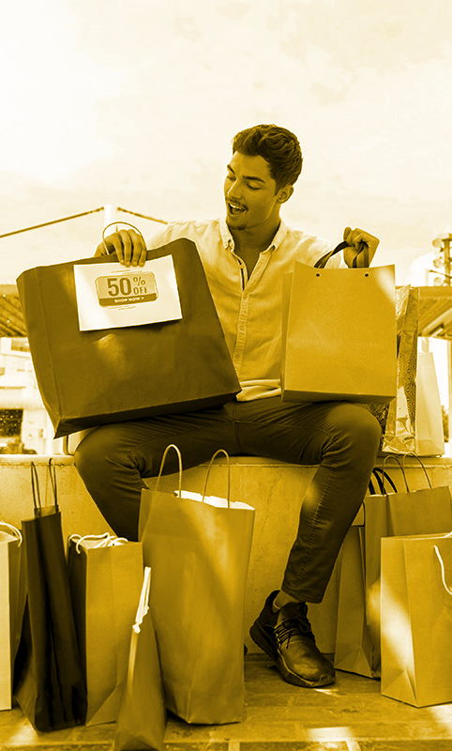
DEMO OF THE PROGRAM
03

Slide 19
DEMO THE PROGRAM

Slide 20

CONCLUSION
04

Slide 21

CONCLUSION
There’s more features that we want to develop:
1. Admin
2. Taking bill
3. Remaining stock
But at now, that’s all the feather that our program have. And these features form our view point are the most standard and necessary of a managing program.

Slide 22

THANKS FOR LISTENING !!

